Slide 1

Project title: Automated Traffic Management System
Introduction:
Traffic congestion increases travel time, fuel consumption, and air pollution in urban cities.
Recent advances in AI and Computer Vision allow traffic monitoring using camera systems that can classify vehicles in real time and enables dynamic traffic analysis.
This project proposes an AI based automated traffic management system that uses computer vision to analyze traffic conditions and dynamically control traffic signals while preventing deadlock situations at intersections.
Motivation:
Current traffic systems cannot adapt to dynamic traffic density, often causing long waiting times and inefficient traffic flow.
Intersections frequently suffer from deadlock situations, where vehicles block the intersection and stop movement in all directions
An intelligent system capable of detecting vehicles, analyzing traffic density, detecting deadlocks, and coordinating traffic signals can significantly improve traffic flow and reduce congestion.
Name: NAVNEET
Roll No: 2301135
Supervisor: Dr Ferdous A Barbhuiya

Slide 2
Existing work / Literature review:
Fixed-Time Traffic Signals : Current traffic signal systems operate using fixed-time scheduling, where the signal timing is predefined.
Traffic Police Control : Traffic police manually control traffic during congestion.
Existing solutions rarely address intersection deadlocks and multi-intersection synchronization, which are major causes of traffic congestion in dense urban environments.
Gaps in the existing solutions/work:
Fixed signal timing cannot adapt to real-time traffic density variations.
Manual traffic control cannot continuously monitor multiple intersections and also labor intensive and expensive.
Existing systems rarely detect intersection deadlocks or coordinate signals across intersections, which are major causes of traffic congestion in dense urban environments.
Name: NAVNEET
Roll No: 2301135
Project Title: Automated Traffic Management System

Slide 3
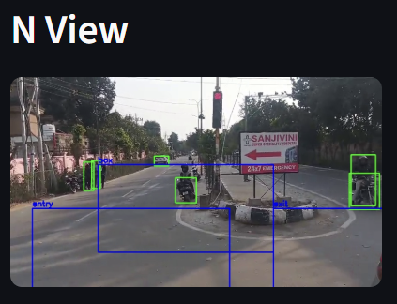
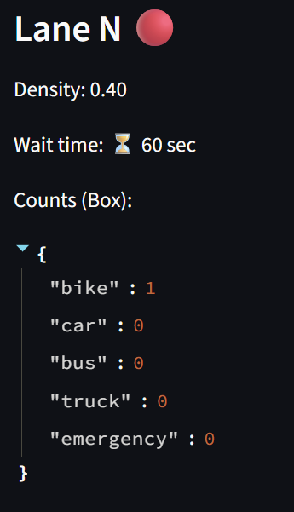
Work Done till date:
Details of proposed work/solutions:
The proposed system integrates Artificial Intelligence and Computer Vision to create an intelligent traffic management framework.
Key components of the system include:
Vehicle Detection using YOLO
Traffic Density Estimation
Deadlock Detection
Deadlock Recovery Mechanism
Adaptive Traffic Signal Scheduling
Emergency Vehicle Prioritization
Result achieved (if any):
The project architecture and modular implementation have been successfully designed, including perception, decision, communication, and visualization layers. YOLO-based detection identifies vehicles, lanes, and intersection zones.
A working prototype has been implemented where traffic videos are processed using YOLO to detect vehicles and estimate traffic density.
The system integrates deadlock detection logic and adaptive traffic signal scheduling with a real-time Streamlit dashboard for visualization.
References:
https://ijrti.org/papers/IJRTI2305036.pdf
Name: NAVNEET
Roll No: 2301135
Project Title: Automated Traffic Management System

